Slide 1
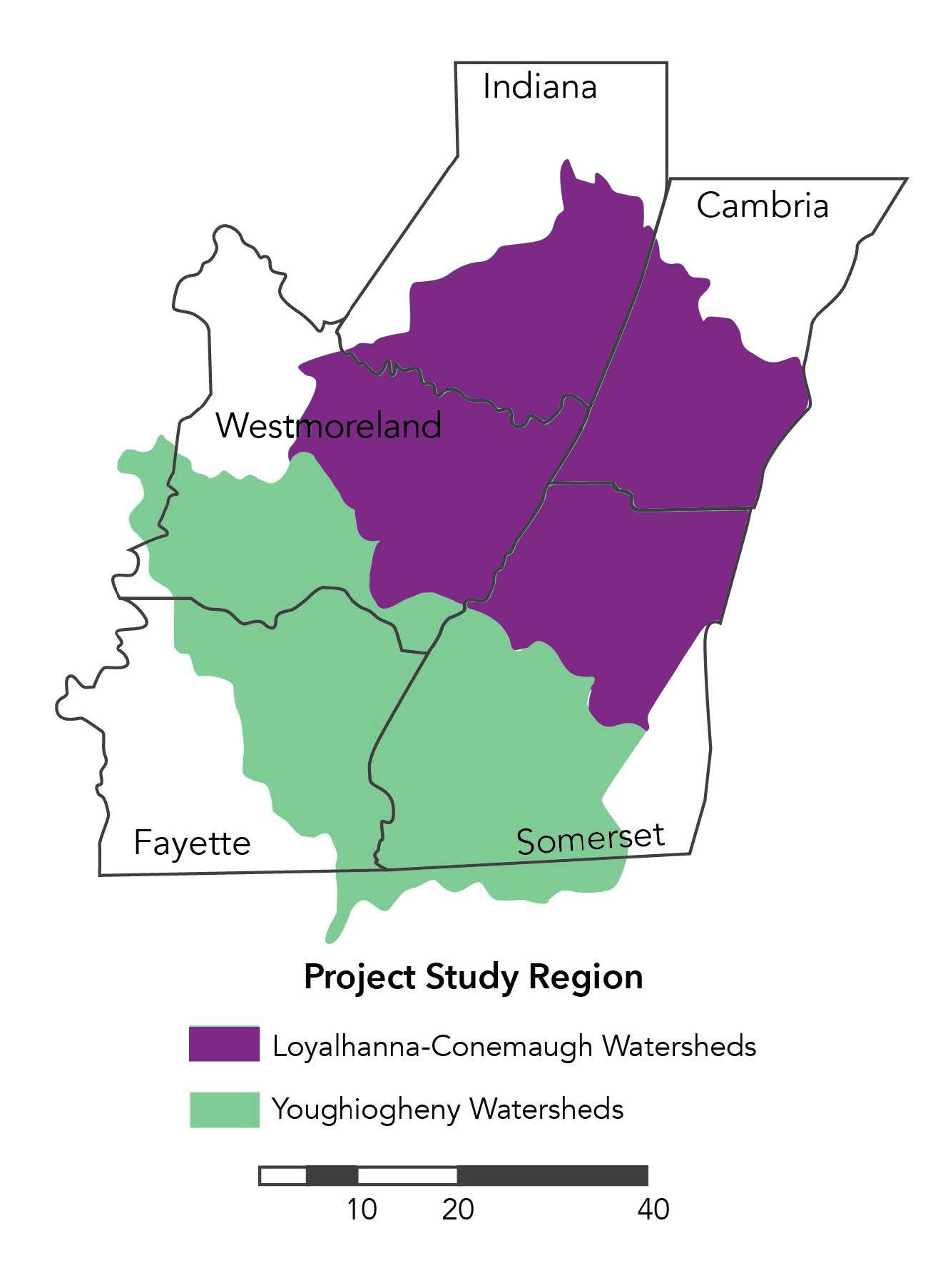
TITLE HERE
SUBHEADING HERE
100 WORD SUMMARY
iaculis nunc sed augue lacus viverra vitae congue eu consequat ac felis donec et odio pellentesque diam volutpat commodo sed egestas egestas fringilla phasellus faucibus scelerisque eleifend donec pretium vulputate sapien nec sagittis aliquam malesuada bibendum arcu vitae elementum curabitur vitae nunc sed velit dignissim sodales ut eu sem integer vitae justo eget magna fermentum iaculis eu non diam phasellus vestibulum lorem sed risus ultricies tristique nulla aliquet enim tortor at auctor urna nunc id cursus metus aliquam eleifend mi in nulla posuere sollicitudin aliquam ultrices sagittis orci a scelerisque purus semper eget duis at tellus at urna condimentum mattis
REPLACE
Chart/graph
DATA (1-2 short sentences, 12pt font)
DATA (1-2 short sentences 12 pt font
DATA (1-2 short sentences, 12 pt font)
KEY TAKEAWAY (HEADING)
Other important info/objectives/action items. Either bullet points or a quick paragraph.
Credit: Credit: Valuing Clean Water: Ecosystem Service Values in the Loyalhanna-Conemaugh and Youghiogheny River Watersheds of the Laurel Highlands Region
Laurel Highlands Conservation Landscape & ANYONE ELSE

Slide 2
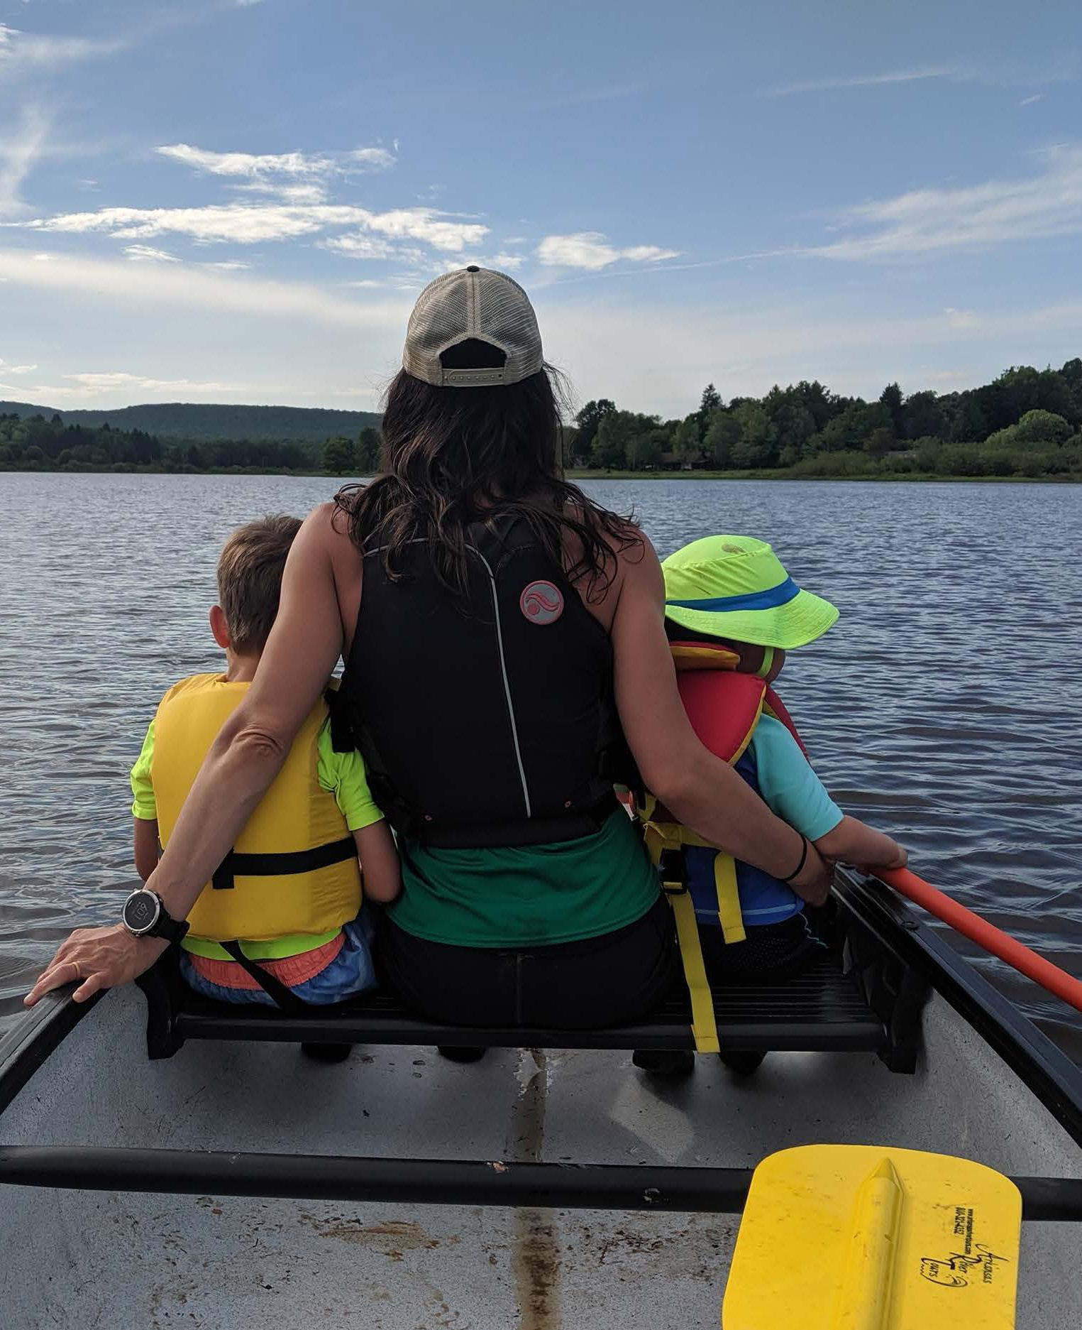
The Value of Water Quality in Outdoor Recreation in the
Youghiogheny Loyalhanna Conemaugh River Basins
Clean water means $3.7 billion in benefits to the region
SUBHEADING HERE
The Laurel Highlands is one of Pennsylvania’s most treasured outdoor recreation destinations. The watersheds in the region offer some of the finest whitewater rafting, hiking, fishing, boating, paddling, swimming, and camping in the United States and attract millions of visitors each year.
These recreational opportunities have given rise to a number of local businesses in small towns throughout the area including breweries, bed and breakfasts, campgrounds, and retail outlets. Tourism has become a vital economic cornerstone of sustainable development in these communities. Water recreation is growing in appeal and health value as summer temperatures rise.
Water recreation attracts 26% of the people who visit the nine state parks in the region. Those visits generate $17 million / year to the local economy.
People come for clean water. 40% of visitors on water trails report that they are concerned about water quality.
Shoreline and trout fishing generate $31.7 million in regional spending.
Residents are willing to pay for clean water
Stream users and non-users living within 90 miles of the Loyalhanna Creek and Conemaugh River are willing to pay between $57 and $82 per year (2018 $) for five years to improve stream quality from moderately polluted to unpolluted.
Credit: Valuing Clean Water: Ecosystem Service Values in the Loyalhanna-Conemaugh and Youghiogheny River Watersheds of the Laurel Highlands Region
Laurel Highlands Conservation Landscape

Slide 3
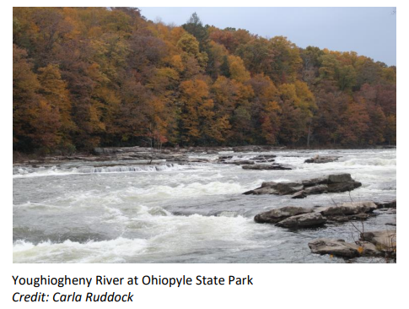
Natural Stream Buffers & Cost-Savings from Reducing Runoff in the Youghiogheny Loyalhanna Conemaugh River Basins
Increased buffers can generate a net benefit of $2.9 million annually
Table 1. Annual and One-Time Benefits & Costs of Establishing Forested Riparian Buffer in Siltation-Damaged Streams
Stormwater runoff, especially from impervious surfaces, is a major challenge in maintaining high-quality streams and waterways. Soil and sediment, along with agricultural chemicals and waste, flow uncontrolled during periods of wet weather, upsetting the natural balance of a watershed ecosystem and degrading the quality of the stream. Natural buffers reduce sedimentation and improve water clarity which can have a positive benefit on aesthetics, recreation, and the overall quality of a waterway. Vegetation along a stream holds the soil in place and reduces the amount of sediment entering a stream as well as the property lost due to erosion. Stormwater management practices are helping property owners address streambank erosion and its associated siltation impacts, particularly on largely uncultivated agricultural lands.
More than 650 miles of streams in the Laurel Highlands region are impaired by excessive siltation, the suspension of dirt in water.
Agriculture runoff impares 242 miles of streams in the study region. Crop- and grazing- related agriculture impares an additional 126 miles.
Converting 1,463 agricultural acres to natural riparian buffers around impared streams could enhance the home value of 1,175 homes equating to a collective $4.65 million increase
Potential Actions:
State-wide, regional, and local programs incorporate ecosystem service benefits into considerations of compensation levels for conserved riparian acres.
Explore compensation schemes between downstream municipalities and upstream landowners.
Credit: Valuing Clean Water: Ecosystem Service Values in the Loyalhanna-Conemaugh and Youghiogheny River Watersheds of the Laurel Highlands Region
Laurel Highlands Conservation Landscape

Slide 4
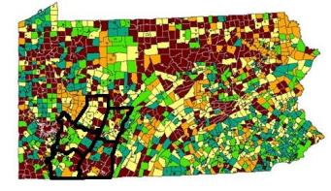
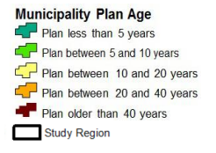
On-lot Sewage Issues in the Youghiogheny Loyalhanna Conemaugh River Basins
Raw Sewage is a Health & Water Quality Concern throughout PA
In Fayette, Indiana, Somerset, and Westmoreland counties, 103 authorities serve an estimated 23,500 people. These authorities can handle drinking water, sewage, or both. Another 124,000 homes rely on on-lot septic systems – some of which are failing. Failing septic systems and outdated public water treatment plans contribute to water pollution which can cause public health risks, degradation of the environment, reduced property values, contaminated drinking water supplies, and streams to become unsafe for water-based recreation. Increased investment for water quality improvements could alleviate these issues by allowing collaboration and partnerships between the authorities, government agencies, and other stakeholders to create an updated sewage plan to provide solutions for existing and future sewage disposal problems and needs.
Figure 1. Act 537 Official Plan Status Map
Source: Department of Environmental Protection, 2015
On-lot sewage currently impairs 40 miles of streams in the study region.
In Pennsylvania, about one in five residential sewage systems are failing. These rates are higher in rural communities.
Act 537 requires all municipalities to develop and implement sewage facilities plans, but 47% of municipalities in the state have a plan that is more than 20 years old.
Potential Actions:
Encourage updated sewage plans that were required under the 1965 Sewage Facilities Act (Act 537).
When looking at failing systems near degraded streams, consider conducting a cost/benefit analysis to either switch to public systems or repair the on-lot system.
Credit: Valuing Clean Water: Ecosystem Service Values in the Loyalhanna-Conemaugh and Youghiogheny River Watersheds of the Laurel Highlands Region
Laurel Highlands Conservation Landscape

Slide 5
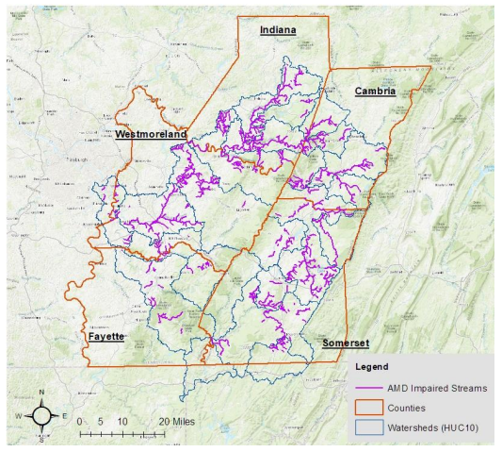
Abandoned Mine Discharge-Impaired Streams in the Youghiogheny Loyalhanna Conemaugh River Basins
Heavy Metal Runoff Impacts Community Assets
Abandoned mine discharge (AMD) represents one of the largest environmental challenges facing Pennsylvania. Restoring water quality for AMD-impaired streams in the Laurel Highlands can provide economic value in the form of higher property values, new recreational angling opportunities, and lower water treatment costs. The ecosystem services associated with these economic benefits are aesthetic value, recreation, and water quality. In 1970, a collaborative AMD treatment program led by the PA DEP, conservation districts, and nonprofits was created and has had a significant impact on affected watersheds – resulting in the return of fish and wildlife to severely impared ecosystems. There are both active and passive water treatment systems, with the passive system being less costly. Annual costs for passive treatment systems are estimated at 4% of capital costs, but the return on investment is significant.
Figure 1. AMD-Imparied Streams in the Laurel Highlands Watersheds
Source: The Pennsylvania Geospatial Data Clearinghouse, 2019
Approximately 900 miles of streams in the study area remain impacted by runoff of heavy metals from abandoned coal mines.
Resident-supported willingness to pay AMD stream restoration could amount to an additional $5.67 million in ecosystem service value.
AMD remediation measures could bring an additional $16.8 million in recreational fishing and raise property values by 5-13% for households within a quarter-mile of an impacted stream. This translates into a one-time economic benefit of $41,133 for each mile of restored stream.
Potential Action:
Incorporate the benefits of AMD remediation into funding decisions.
Credit: Valuing Clean Water: Ecosystem Service Values in the Loyalhanna-Conemaugh and Youghiogheny River Watersheds of the Laurel Highlands Region
Laurel Highlands Conservation Landscape

